Slide 1
The Human Factor of Mergers & Acquisitions
HOW TO RETAIN TOP PERFORMERS POST-INTEGRATION
Andrew Partheniou | Jimmy Song | Simon Foucher | Stefanie Perrone

Slide 2
Current State
70% M&As fail to deliver on targets
Business focus on Financial
M&As are disruptive life events
OB Focus on People
Lost of identity
Culture clash
Uncertainty / Stress
Need to consider the “Human Factor” in M&As

Slide 3
Key Success Factors
Identity
Motivation
Process
Culture
COMMUNICATION
Human factors are critical to ensure retention of key people

Slide 4
Identity
Who am I in this new Organization?

Slide 5
Identity
Work Place
Family
Social Circles
Identity
Work organization play a crucial role in shaping identity

Slide 6
4 Approaches to post-merger Identity
Assimilation
Confederation
Federation
Metamorphosis
Excpet for federation, all outcomes imply changes

Slide 7
Assimilation & Metamorphosis: cope with new identity
Build Trust
Justice
Sell Benefits
Stability
Goal: Reduction of insecurity and stress for individuals

Slide 8
Culture
Understand Norms and Expectation

Slide 9
How to Merge Culture
Culture Integration – Overview
What is Culture?
Shared Meaning
Why is it Important?
Conflict Avoidance
Understand Norms and Expectations
Aligns Expectation
Pre-Merger
Planning
Implementing
Reviewing
Successful culture integration reduces chances of failure

Slide 10
Stage 1 – Pre Merger
Innovation
Relationships
Autonomy
Performance / Reward
Risk
Key to success is to clearly identify culture differance

Slide 11
Stage 2 - Planning
Object
What dimension to integrate
Goal
Clarify
Method
Budget
Which ones
Time Table
Training
Other items
A day invested in planning saves a week of issues in implementation

Slide 12
Stage 3 - Implementation
Create atmosphere of integration
Clarify Norms
Build Trust
Communicate
Prepare for Conflict
Equity
Many tools to chose from to integrate culture

Slide 13
Stage 4 – Review Stage
Find Difference
Explain Difference
Document findings
Take action
Revise technique
Results Vs. Expected
Apply at next merger
Continuously improve integration performance

Slide 14
Motivation
Individual View of Retention

Slide 15
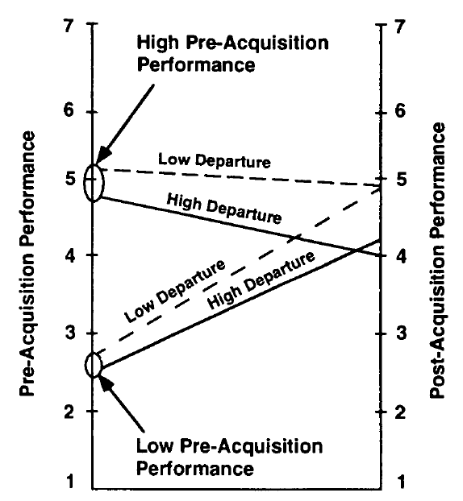
Identify Top Executives
Executives
High Salary
High corporate ROA
Companies of comparable size
Only invest in keeping key executives

Slide 16
Top guns at the Non-Executive Level
Combination of 2 our of 3 Methods
Document & Data Approach
Surveys
Social Network Mapping
Target the right individuals

Slide 17
Intrinsic Retention Programs
Executives
Promotion Possibilities
Workforce
Address job security concerns
Power shift from shareholders to managers
Parent CEO controls high share volume
Maintain intrinsic motivation

Slide 18
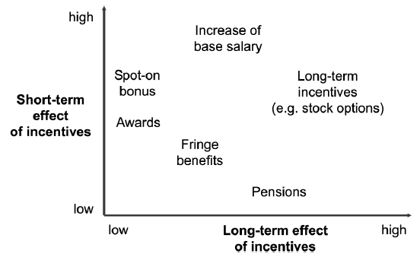
Extrinsic Retention Programs
Avoid going down Maslow’s needs hierarchy

Slide 19
Communication & Process
Ensure Reality Matches the Theory

Slide 20
Organizational Citizenship Behaviour
Increase perceptions of OCB Dimensions
Increase OB through effective communication
Increase Employee Happiness (Satisfaction)
Increase employee loyalty and retention
Communication satisfaction is positively and significantly related to OCB
Notes:
Dimensions of OCB: Conscientiousness, sportsmanship, courtesy, civic culture and altruism

Slide 21
The Communication Triad
Communication
Organizational Commitment
Trust
Communication and trust increases organizational commitment
Notes:
Communication and trust are strongly correlated
Each are related to organizational commitment: Employee loyalty → Employee retention

Slide 22
Formal and Informal Communication
Strategize
Strategize and prepare a formal communication plan
Use a truthful approach at all times
Timing
Implement frequent communications
Truth
Remain consistent
Over-communicate
Reinforce
Manage Change
Use “Transition Teams”
Reinforce leadership credibility and forge trust

Slide 23
Process for Communication Transfer
Communication fragmentation causes
Identify and select process information
Mitigation Approaches
Knowledge blind spots
Knowledge Mismatches
Knowledge Jail
Plan how information is collected
Document information transfer
Translate into useful applications (e.g.: Framework)
Reinforcement (e.g.: transition teams)
Formalized process changes reduces employees uncertainty
Notes:
Bind spots: Not knowing how information on processes is currently held
Mishaps: Documented processes do no indicate reasoning for processing
Jail: Abundant Information

Slide 24
Conclusion
Culture/
Identity
Motivate
Communicate
Process

